Slide 1
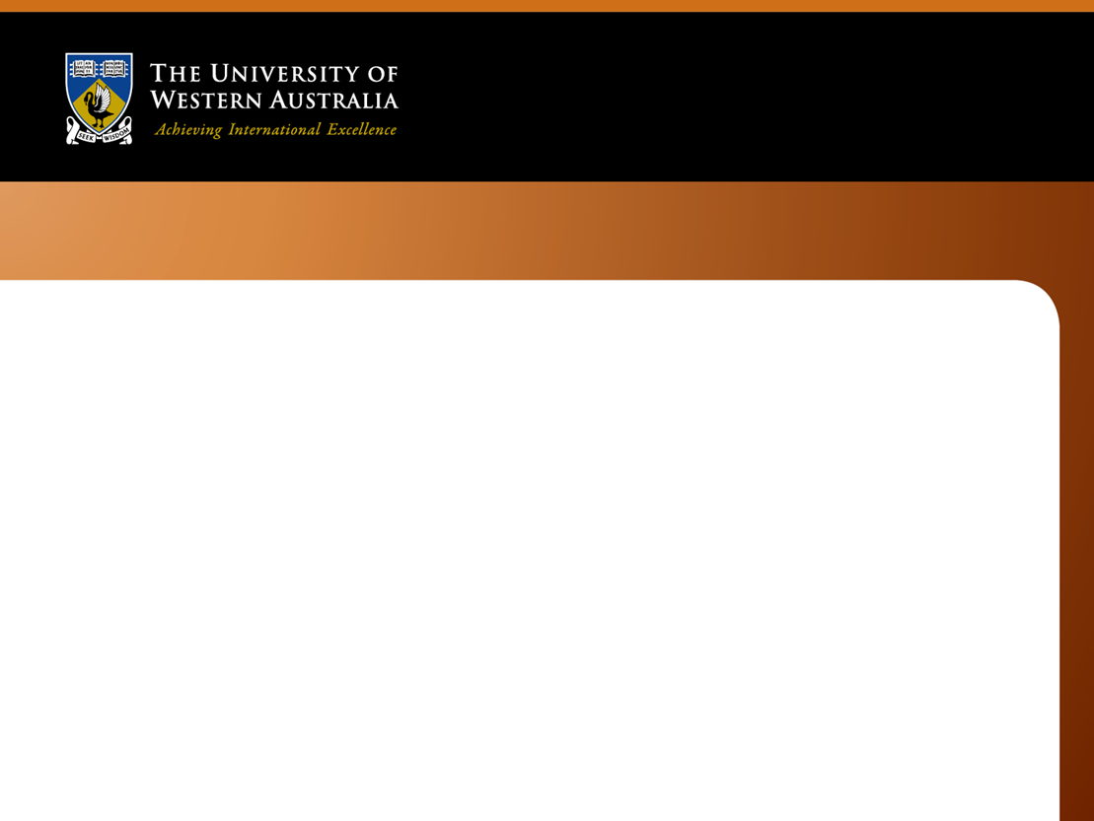
Value creation in the engineering enterprise
James Trevelyan
Notes:
In our own community and even worldwide, engineers could do much to improve their reputation. Consider, for instance, the following quote from a research interview:
“I get rid of engineers from my organisations wherever I find them.”
This is not an isolated comment: this has been a recurring theme from interviews with business and government leaders.
Quantitative indicators back up these qualitative perceptions. For example, analysis of the results of hundreds of billions of dollar worth of capital projects across the world, almost all of which were engineering projects, has shown that success rates are around one in three for projects over $1 billion and about two in three for smaller projects. Business leaders are acutely aware of this issue.
Consulting engineers, according to Australian surveys of professional service quality, rank equal bottom with IT technicians.
In this seminar I will discuss some of our discoveries from studying engineering practice that help to explain these reputation issues. These discoveries point to ways that we, as a community of engineers, could work towards restoring the high reputation we once enjoyed. We might also help to fix some major sustainability issues along the way.
Some of the discussion may be challenging for engineering educators. For example, I will argue that we even need to rework the philosophical foundations of engineering to bring them into line with the ways that expert engineers practice their profession. We need to step away from the idea that engineers are problem solvers, and start to learn more about how engineers deliver value for clients and society at large, something we have mostly lost sight of.
Brief Biography of Speaker:
Professor James Trevelyan teaches part-time in the Mechanical and Chemical Engineering School at The University of Western Australia, is a Fellow of Engineers Australia, and practices as a mechanical and mechatronics engineer developing new air conditioning technology.
His main area of research is on engineering practice and he has recently published a major book: “The Making of an Expert Engineer.”
He is well known internationally for robotics research and more recently his work on engineering practice. He recently gave the keynote address at the IPENZ Annual Professions Forum in Wellington.

Slide 2


Slide 3
Outline
My journeys
Paris – Tunis differences
Economics
Value and value creation
Engineering value creation
Why is this important?
Notes:
Learning from Expert Engineers
James Trevelyan, The University of Western Australia
Engineers in New Zealand are experiencing unaccustomed visibility, and not for reasons we can all be comfortable with. The consequences of the Christchurch earthquake have to some extend tarnished the public reputation of the engineering profession.
Is this simply a communication issue? Can we address this by improving engineers’ ability to communicate effectively, with clients, government, and society at large?
12 years of research on engineering practice involving 25 researchers and several hundred engineers tells us that a more extensive response is likely to be needed.
There are many challenges that we, as engineers, will have to overcome to restore our professional reputation and community confidence.
One challenges is to appreciate that communication is much more than simply the transfer of information: a notion that is deeply embedded in the profession today. It is much more than that: communication is the means by which we as engineers collaborate with all the people from whom we need support to deliver the results that our clients and society expect. Technical collaboration is a series of complex socio-technical performances, and expert engineers distinguish themselves by being able to do this better than most others. To do it well, we also need to appreciate that communication is part of relationship building, and the means by which we can shape perceptions of other people.
The research also demonstrates that any engineer can become expert in their chosen areas of specialisation through several years of specially tailored practice with performance evaluation, preferably from experienced peers and colleagues. Engineers who master technical and collaboration skills can look forward to greater career satisfaction, and higher earnings for themselves and their employers.
Knowledge of technical collaboration skills has been allowed to dissipate over time. Now that the knowledge used by experts is available in written form, the next challenge is for practicing engineers to make the effort to learn from it. Such efforts will almost certainly be handsomely rewarded, not the least in terms of enhancing the reputation of the whole profession.
Professor Trevelyan will address several other ways in which engineers can rebuild their professional reputation among clients, government, end-users and society at large.

Slide 4
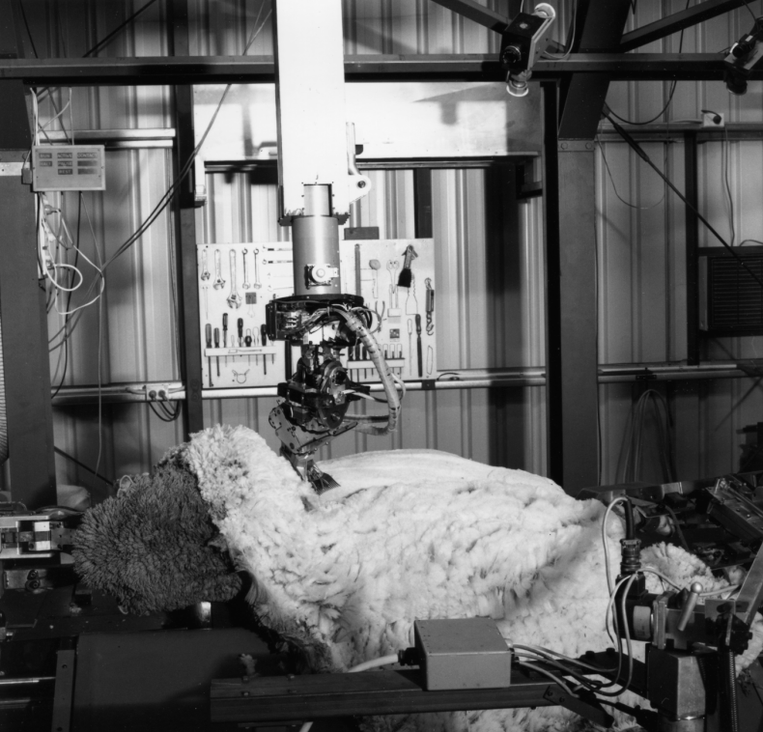
1976-1993
Youtube: “robot sheep shearing”
Notes:
Here is the robot in action, towards the end of its working life in about 1992 at Murdoch University. The robot was relocated there because it was easier to access sheep in the numbers that we needed for extensive trials. There was insufficient space in the Mechanical Engineering building here at UWA.
The robot was fully automatic: you can see it operating on YouTube

Slide 5
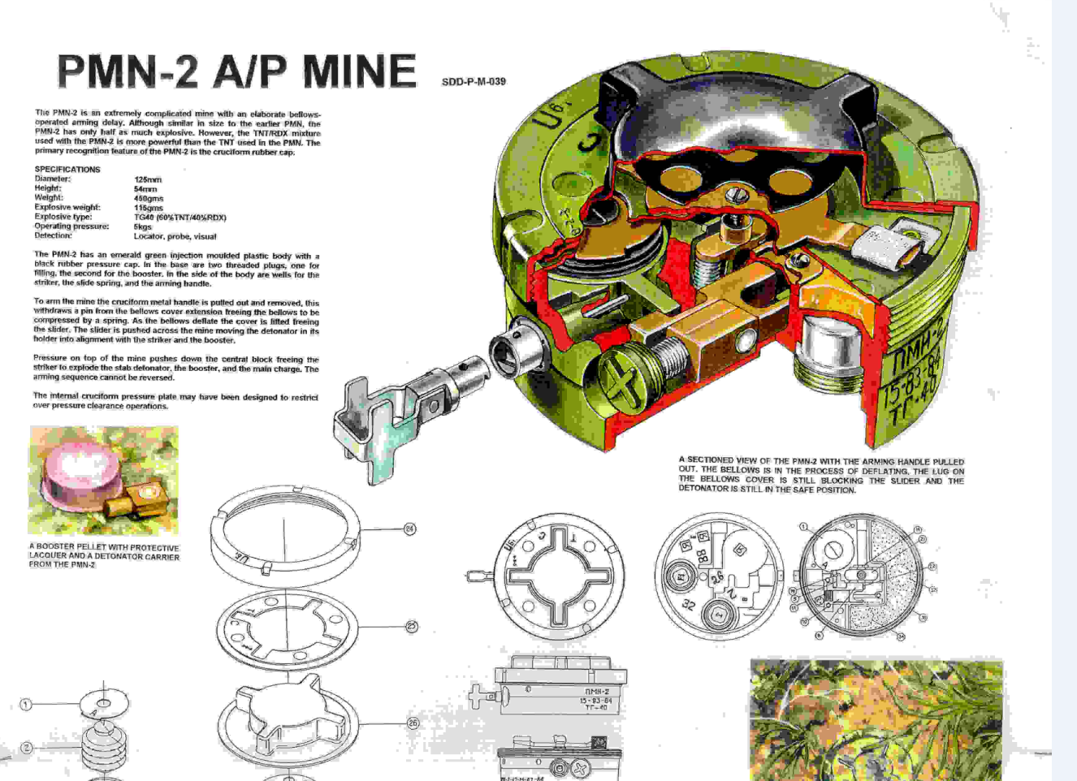
1996 - 2002

Slide 6
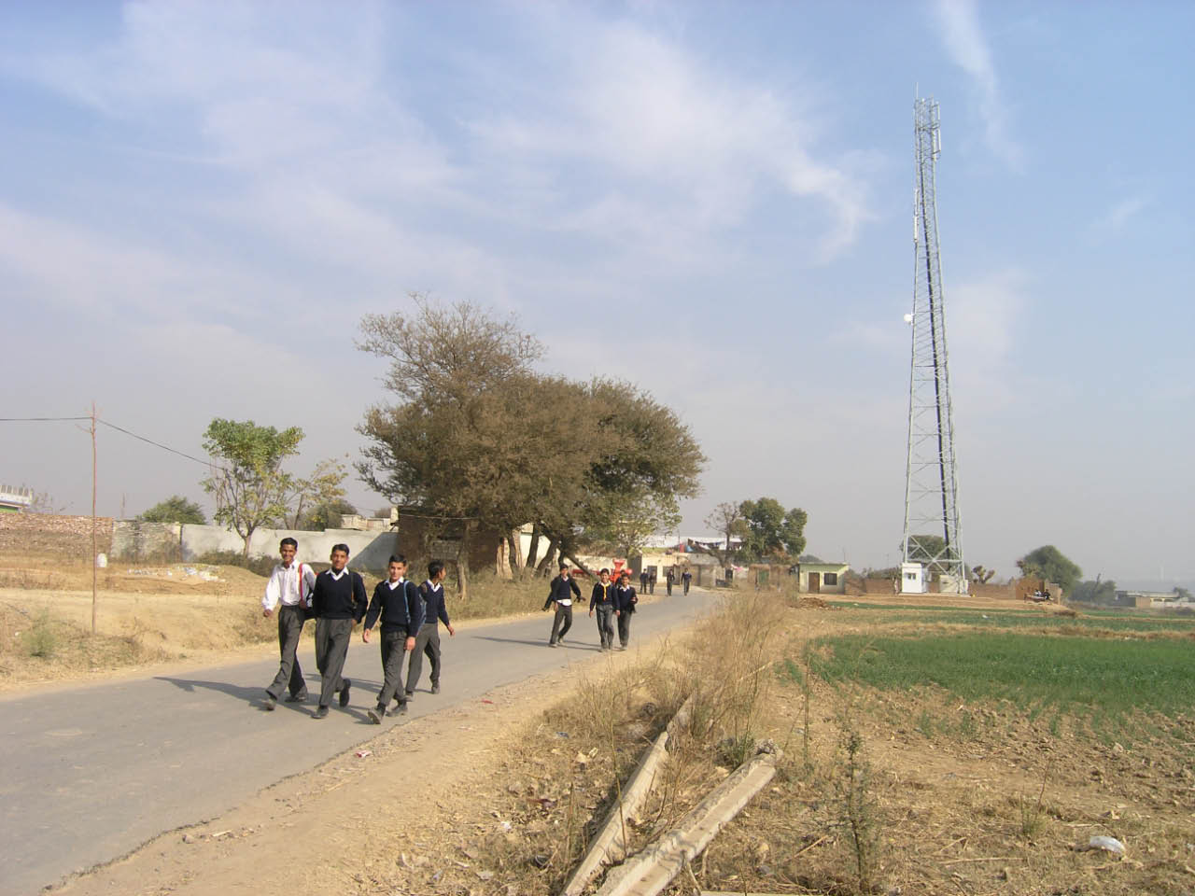

Slide 7


Notes:
The commercial product we are about to launch on the world market.

Slide 8
Challenges Evident in Pakistan
Engineers’ pay in low income countries
  ~ 0.25 – 0.35 industrialised country rates
Low capital investment
  foreign engineers get big contracts
Engineers migrate to US (France, Canada)
High cost engineered services
  Energy
  Safe drinking water
  Construction
  Transport

Slide 9
Outline
My journeys
Paris – Tunis differences
Economics
Value and value creation
Engineering value creation
Why is this important?
Notes:
Learning from Expert Engineers
James Trevelyan, The University of Western Australia
Engineers in New Zealand are experiencing unaccustomed visibility, and not for reasons we can all be comfortable with. The consequences of the Christchurch earthquake have to some extend tarnished the public reputation of the engineering profession.
Is this simply a communication issue? Can we address this by improving engineers’ ability to communicate effectively, with clients, government, and society at large?
12 years of research on engineering practice involving 25 researchers and several hundred engineers tells us that a more extensive response is likely to be needed.
There are many challenges that we, as engineers, will have to overcome to restore our professional reputation and community confidence.
One challenges is to appreciate that communication is much more than simply the transfer of information: a notion that is deeply embedded in the profession today. It is much more than that: communication is the means by which we as engineers collaborate with all the people from whom we need support to deliver the results that our clients and society expect. Technical collaboration is a series of complex socio-technical performances, and expert engineers distinguish themselves by being able to do this better than most others. To do it well, we also need to appreciate that communication is part of relationship building, and the means by which we can shape perceptions of other people.
The research also demonstrates that any engineer can become expert in their chosen areas of specialisation through several years of specially tailored practice with performance evaluation, preferably from experienced peers and colleagues. Engineers who master technical and collaboration skills can look forward to greater career satisfaction, and higher earnings for themselves and their employers.
Knowledge of technical collaboration skills has been allowed to dissipate over time. Now that the knowledge used by experts is available in written form, the next challenge is for practicing engineers to make the effort to learn from it. Such efforts will almost certainly be handsomely rewarded, not the least in terms of enhancing the reputation of the whole profession.
Professor Trevelyan will address several other ways in which engineers can rebuild their professional reputation among clients, government, end-users and society at large.

Slide 10

USD 35-50
Around 3 billion people
Hundreds of millions of children.
45% children stunted due to faecal contamination
16:9 mask
Asianet Pakistan / Shutterstock
Notes:
Water that is carried, after it is boiled, costs around $35 per tonne

Slide 11
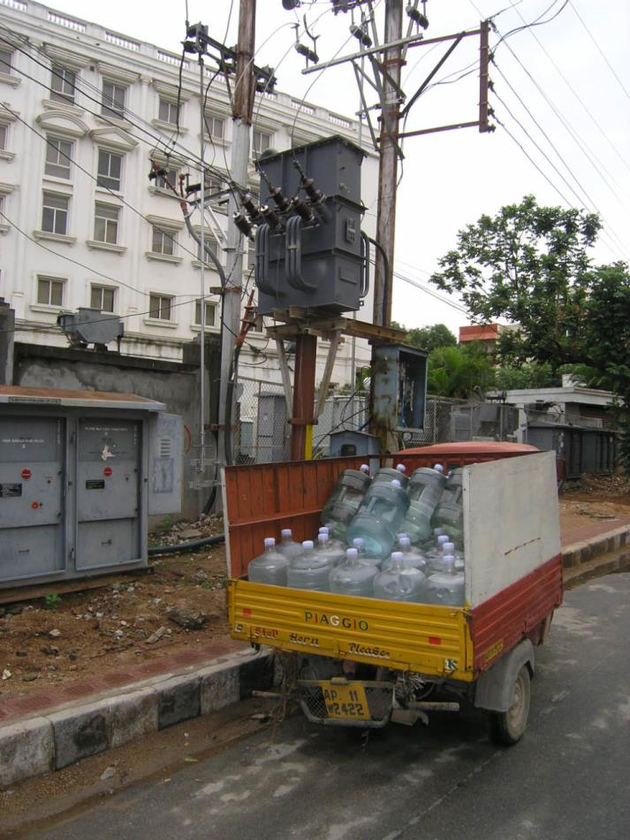
USD 70-130
Hyderabad, India
Notes:
Water delivered in 20 litre plastic containers costs $70 / tonne

Slide 12

USD 3
(Perth cost,
including connection, 2016)

Slide 13
Energy Supplies
Load shedding (intermittent power) in many countries doubles or triples the cost of electric energy.
  Generators or batteries
  Equipment damage
  Process discontinuities

Slide 14
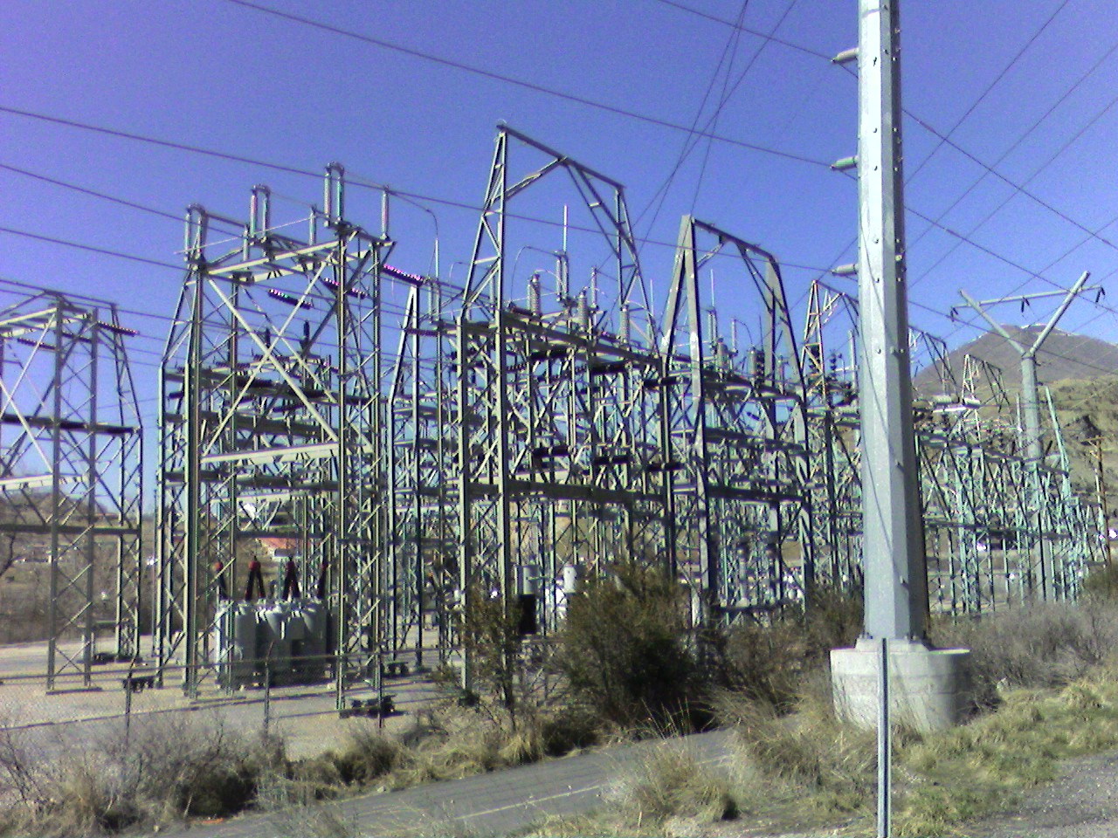
“We must have trained around 300,000 electrical engineers in Pakistan and India, yet load shedding and blackouts are more frequent every year, here 50% of the time.”
(University Vice Chancellor, Lahore)
http://en.wikipedia.org/wiki/Electric_power_transmission

Slide 15
Theoretical Foundations

Slide 16
Engineering: Problem Solving
Engineers find optimal solutions in the presence of constraints.
"The engineering method (often called design) is the use of heuristics to cause the best change in an uncertain situation within the available resources.”
Billy Koen, The Engineering Method and its Implications for Scientific, Philosophical and Universal Methods, 2009
Notes:
This is the classical definition of engineering – it needs to be replaced

Slide 17
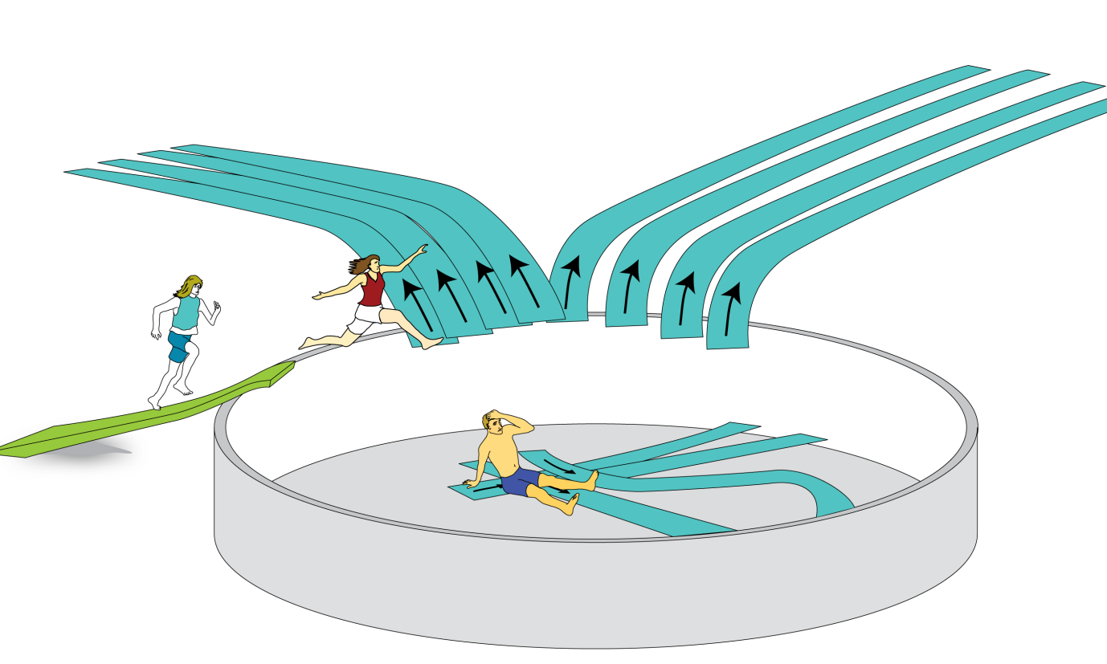
Theory-based education shapes a discipline
Engineering students at university learn to write mathematical solutions for narrowly defined technical analytical problem in examinations.

Slide 18
Paris – Tunis differences?

Slide 19
Paris – Tunis differences?
Pakistan – India – Australia comparison
15 years of research by 25 contributors
~330 engineer interviews
10 field studies
Longitudinal and occupational surveys
Nature of engineering work practices

Slide 20
What do engineering graduates do in their first job?

Slide 21
What do engineering graduates do in their first job?
While it may see non-technical, analysis shows the social interactions are largely about technical issues

Slide 22
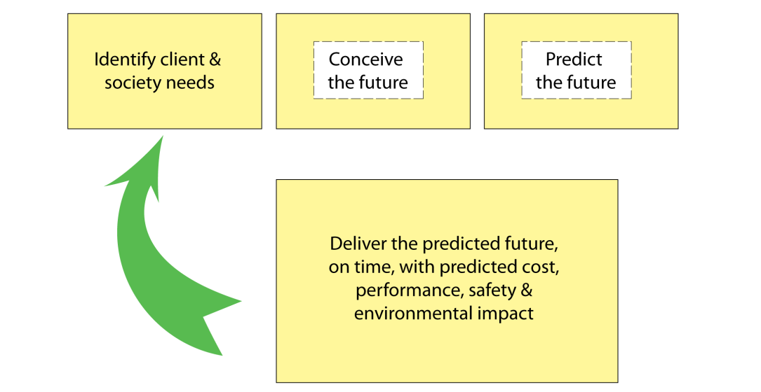
A view of engineering practice

Slide 23
A view of engineering practice
☑
☑
☒
☒
☒
☒
Notes:
The missing parts that students need to learn about

Slide 24
Binary Model
Engineering science and empirical knowledge
  Developed, carried in minds of engineers
Technical collaboration in an enterprise:
  Align human actions with original technical intentions
  Sufficient alignment to achieve predicted results

Slide 25
What do we teach?
Engineering science, 2-20% of practice
What do we not teach?
Technical planning, foresight
Technical collaboration 80 - 98% of practice

Slide 26
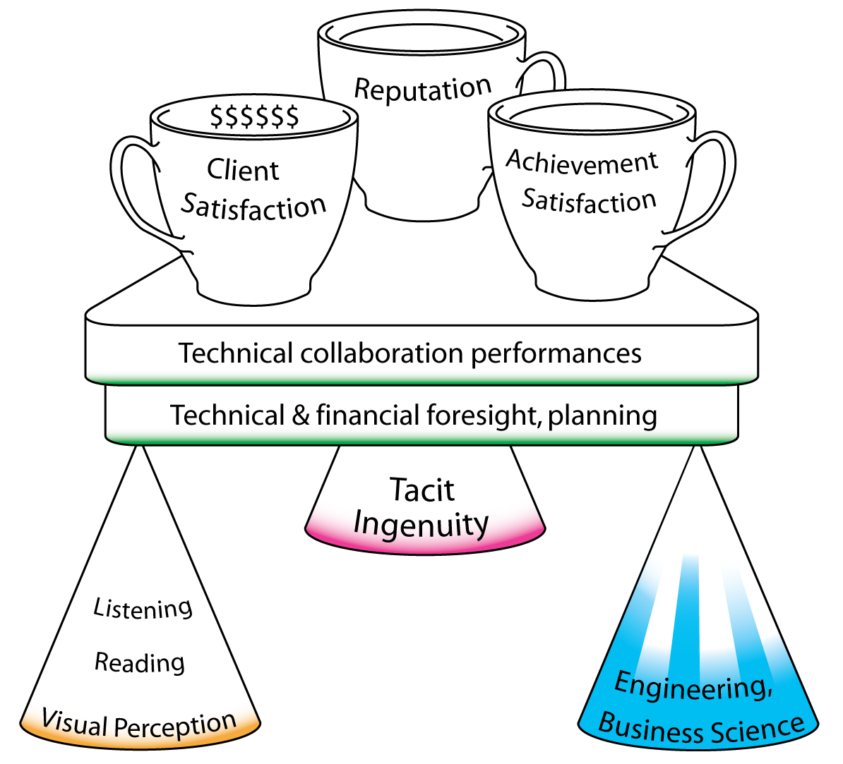
Engineering Practice

Slide 27
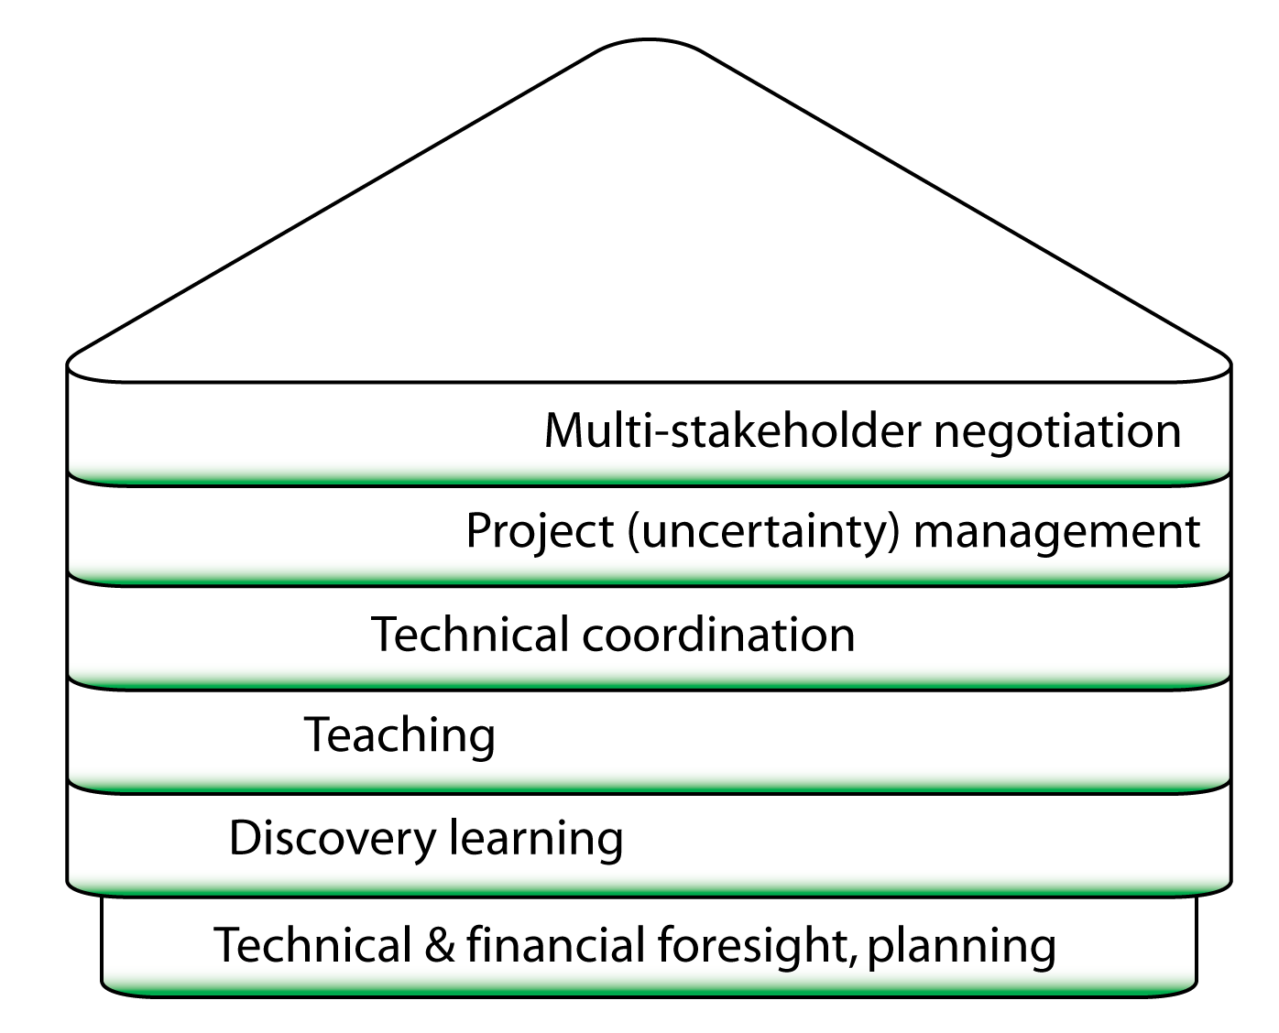
Technical Collaboration Performances

Slide 28
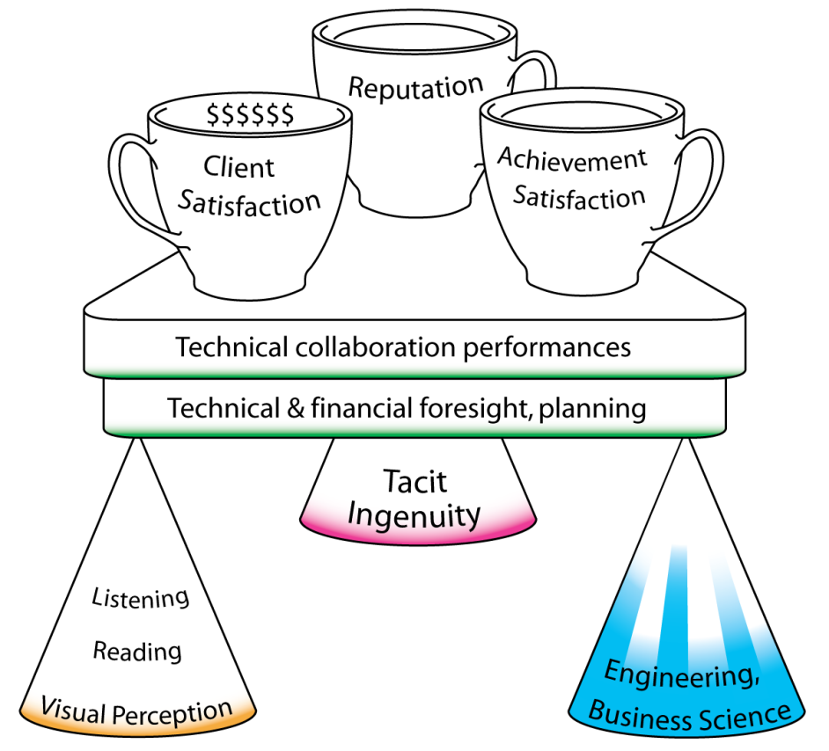
Value Creation
Value
creation
Trevelyan, James P. (2014) The Making of an Expert Engineer, Taylor & Francis
Notes:
Expert performance in engineering practice, in its essence, is a combination of technical and financial foresight and planning, combined with the technical collaboration performances required to convert plans into reality. These layers in turn are supported with three foundations: engineering and business science, tacit ingenuity, and accurate perception skills. Unfortunately, our education systems focus only on one of the three foundations and this focus is represented in the diagram by coloured shading. While tacit ingenuity can accumulate through education, it is not encouraged by appropriate incentives. As chapter 6 explained, there are three fundamental neglected perception skills without which expert performances are not possible.

Slide 29
Paris – Tunis differences?
Engineering science and empirical knowledge
  Developed, carried in minds of engineers
Technical collaboration in an enterprise:
  Align human actions with original technical intentions
  Sufficient alignment to achieve predicted results
Same
Different

Slide 30
Outline
My journeys
Paris – Tunis differences
Economics
Value and value creation
Engineering value creation
Why is this important?
Notes:
Learning from Expert Engineers
James Trevelyan, The University of Western Australia
Engineers in New Zealand are experiencing unaccustomed visibility, and not for reasons we can all be comfortable with. The consequences of the Christchurch earthquake have to some extend tarnished the public reputation of the engineering profession.
Is this simply a communication issue? Can we address this by improving engineers’ ability to communicate effectively, with clients, government, and society at large?
12 years of research on engineering practice involving 25 researchers and several hundred engineers tells us that a more extensive response is likely to be needed.
There are many challenges that we, as engineers, will have to overcome to restore our professional reputation and community confidence.
One challenges is to appreciate that communication is much more than simply the transfer of information: a notion that is deeply embedded in the profession today. It is much more than that: communication is the means by which we as engineers collaborate with all the people from whom we need support to deliver the results that our clients and society expect. Technical collaboration is a series of complex socio-technical performances, and expert engineers distinguish themselves by being able to do this better than most others. To do it well, we also need to appreciate that communication is part of relationship building, and the means by which we can shape perceptions of other people.
The research also demonstrates that any engineer can become expert in their chosen areas of specialisation through several years of specially tailored practice with performance evaluation, preferably from experienced peers and colleagues. Engineers who master technical and collaboration skills can look forward to greater career satisfaction, and higher earnings for themselves and their employers.
Knowledge of technical collaboration skills has been allowed to dissipate over time. Now that the knowledge used by experts is available in written form, the next challenge is for practicing engineers to make the effort to learn from it. Such efforts will almost certainly be handsomely rewarded, not the least in terms of enhancing the reputation of the whole profession.
Professor Trevelyan will address several other ways in which engineers can rebuild their professional reputation among clients, government, end-users and society at large.

Slide 31
Ideas from Labour Market Economics

Slide 32
Value of Unpaid Labour, Value of Time
≈ 2/3 local female earning rate
Carrying water
  ~ 10 litres per person per day
  ~ 15 litres per trip
  1 hour round trip time
  Boiling time, fuel use
  Storage cost (space)

Slide 33
Marginal revenue productivity theory of wages
Wages ∝ Marginal Production (value added)
  Labour market constraints?
  Regulation?
  Unions?
  Power of capital?

Slide 34
Low Pay for Engineers
Labour market constraints?
Regulation?
Unions?
Power of capital?
Low pay ⇒ low value addition

Slide 35
Economic Development
Schumpeter (1934): “Circular Flow”
Step changes in economic equilibrium
New ‘good’
(or attribute of existing good)
New production method
New market
New source of components or materials
Reorganisation of an industry
Credit is needed (finance, slack capacity)
Schumpeter, J. (1934). The Theory of Economic Development. Cambridge, Massachussetts, USA: Harvard University Press.

Slide 36
The Entrepreneur
Schumpeter (1934)
Has to be a leader
Referent authority (Raven 1992)
Vision, imagining a different future
Mobilises people (and their resources, credit)
Schumpeter, J. (1934). The Theory of Economic Development. Cambridge, Massachussetts, USA: Harvard University Press.
Raven, B. H. (1992). A Power/Interaction Model of Social Influence: French and Raven Thirty Years Later. Journal of Social Behavior and Personality, 7(2), 217-244.

Slide 37
Outline
My journeys
Theoretical foundation for engineering
Entrepreneurs, economic development
Value and value creation
Engineering value creation
Why is this important?
Notes:
Learning from Expert Engineers
James Trevelyan, The University of Western Australia
Engineers in New Zealand are experiencing unaccustomed visibility, and not for reasons we can all be comfortable with. The consequences of the Christchurch earthquake have to some extend tarnished the public reputation of the engineering profession.
Is this simply a communication issue? Can we address this by improving engineers’ ability to communicate effectively, with clients, government, and society at large?
12 years of research on engineering practice involving 25 researchers and several hundred engineers tells us that a more extensive response is likely to be needed.
There are many challenges that we, as engineers, will have to overcome to restore our professional reputation and community confidence.
One challenges is to appreciate that communication is much more than simply the transfer of information: a notion that is deeply embedded in the profession today. It is much more than that: communication is the means by which we as engineers collaborate with all the people from whom we need support to deliver the results that our clients and society expect. Technical collaboration is a series of complex socio-technical performances, and expert engineers distinguish themselves by being able to do this better than most others. To do it well, we also need to appreciate that communication is part of relationship building, and the means by which we can shape perceptions of other people.
The research also demonstrates that any engineer can become expert in their chosen areas of specialisation through several years of specially tailored practice with performance evaluation, preferably from experienced peers and colleagues. Engineers who master technical and collaboration skills can look forward to greater career satisfaction, and higher earnings for themselves and their employers.
Knowledge of technical collaboration skills has been allowed to dissipate over time. Now that the knowledge used by experts is available in written form, the next challenge is for practicing engineers to make the effort to learn from it. Such efforts will almost certainly be handsomely rewarded, not the least in terms of enhancing the reputation of the whole profession.
Professor Trevelyan will address several other ways in which engineers can rebuild their professional reputation among clients, government, end-users and society at large.

Slide 38
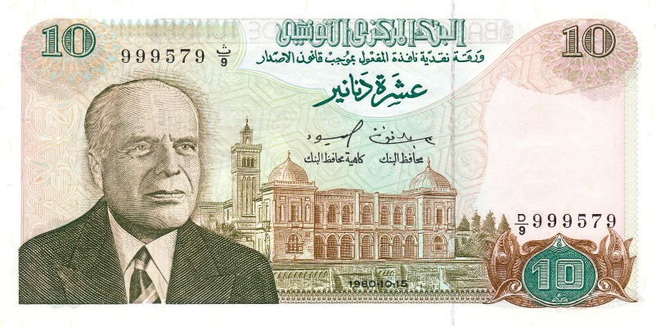
Value?
X=2.7266754?
$, € or TND?
Exchange-value
Artefact acquisition, or entitlement to service
Use-value (actual, or anticipation of)
Subjective experience, perception
Unique to each person
Depends on circumstances, time
Co-created by provider and user
Ng, I. C. L., Parry, G., Smith, L. A., & Maull, R. S. (2010). Value co-creation in Complex Engineering Service Systems: Conceptual Foundations Forum Markets and Marketing: Extending the Service Dominant Logic (pp. 19): University of Exeter Business School Discussion Papers in Management 10/04.

Slide 39
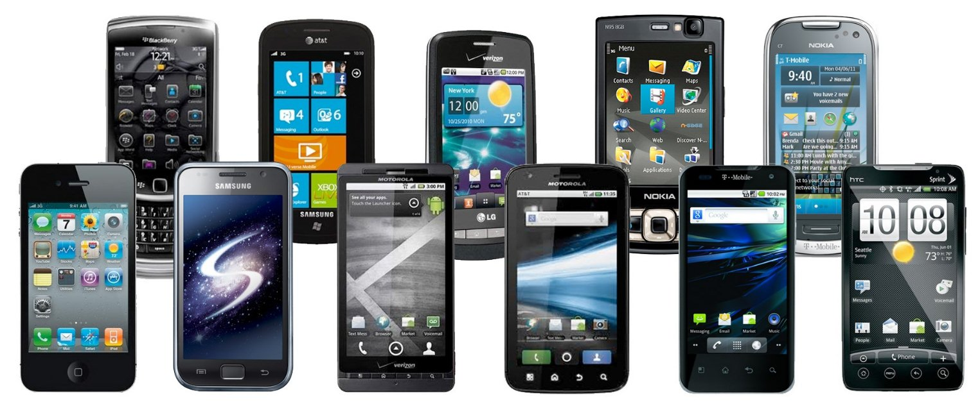
Value?
gadgetadda.com, March 2016

Slide 40
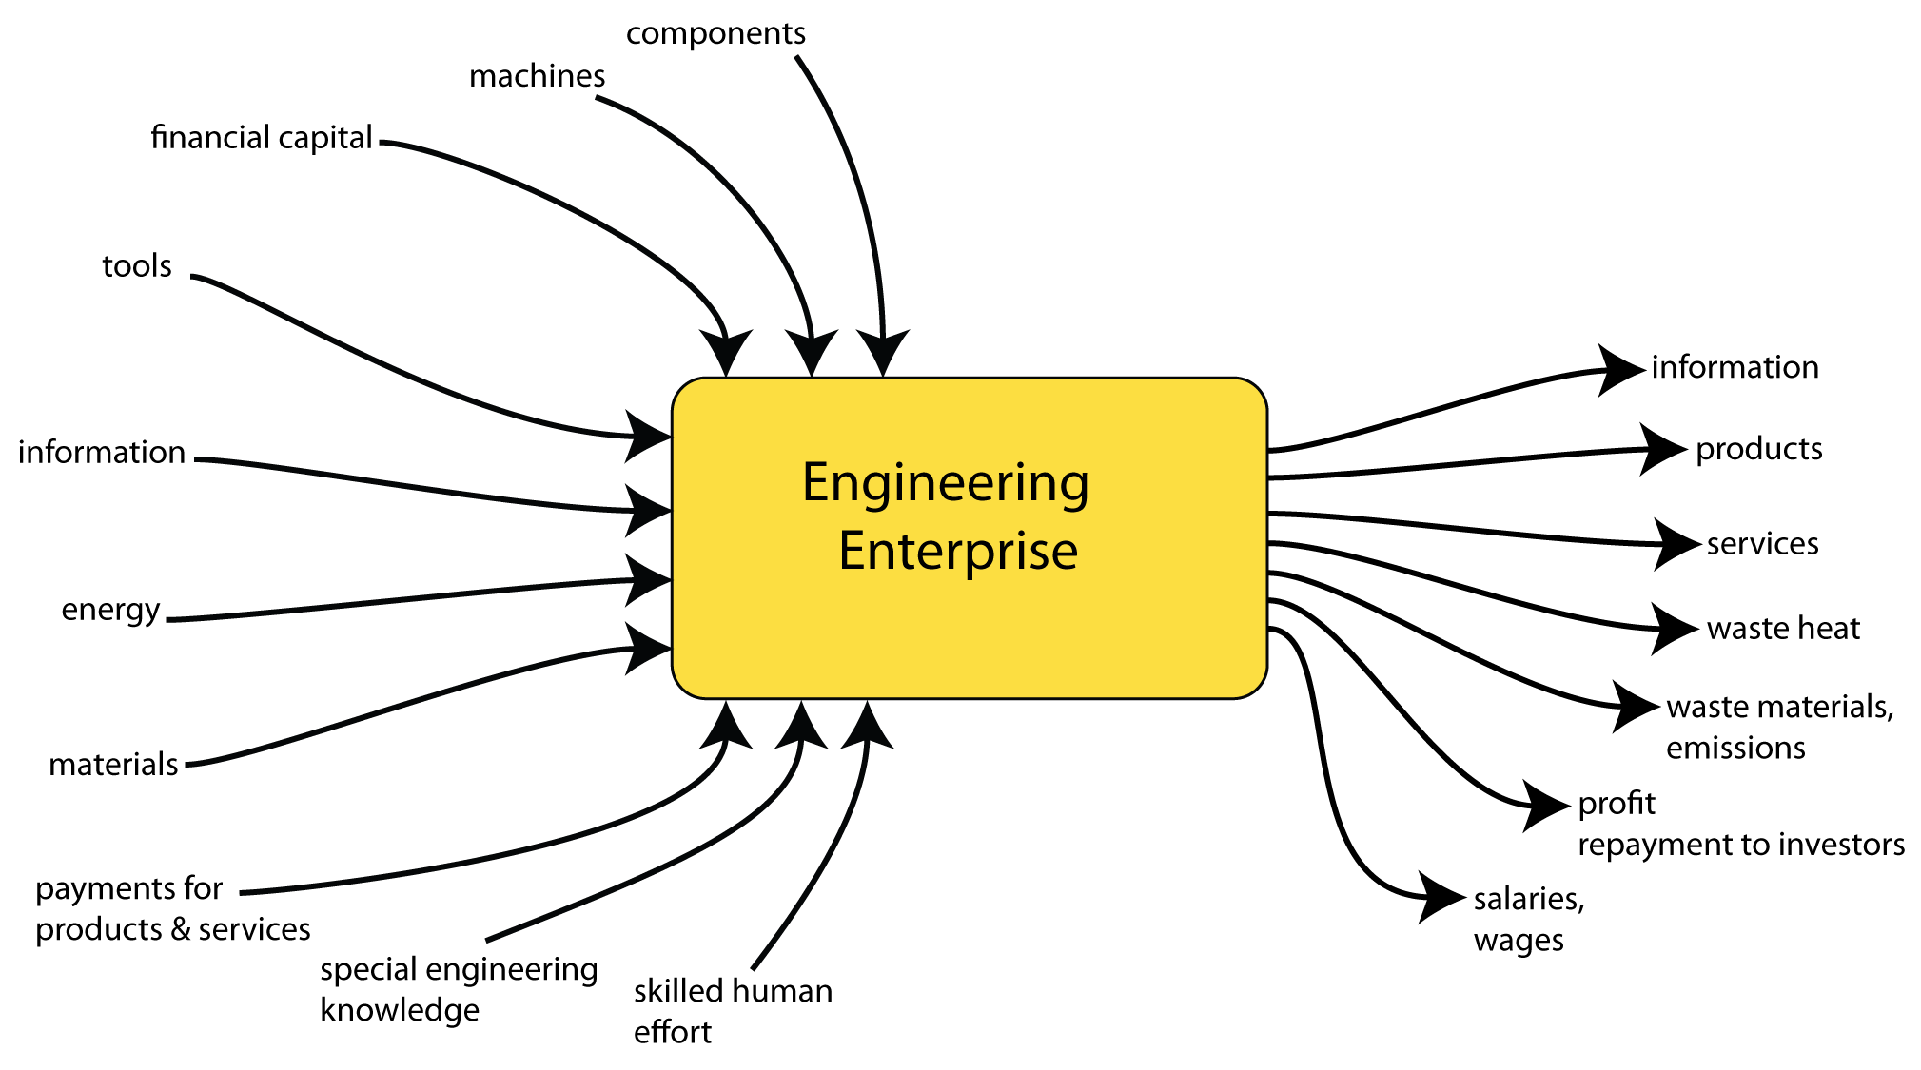
The firm (or enterprise)
Ch5, The Making of an Expert Engineer

Slide 41
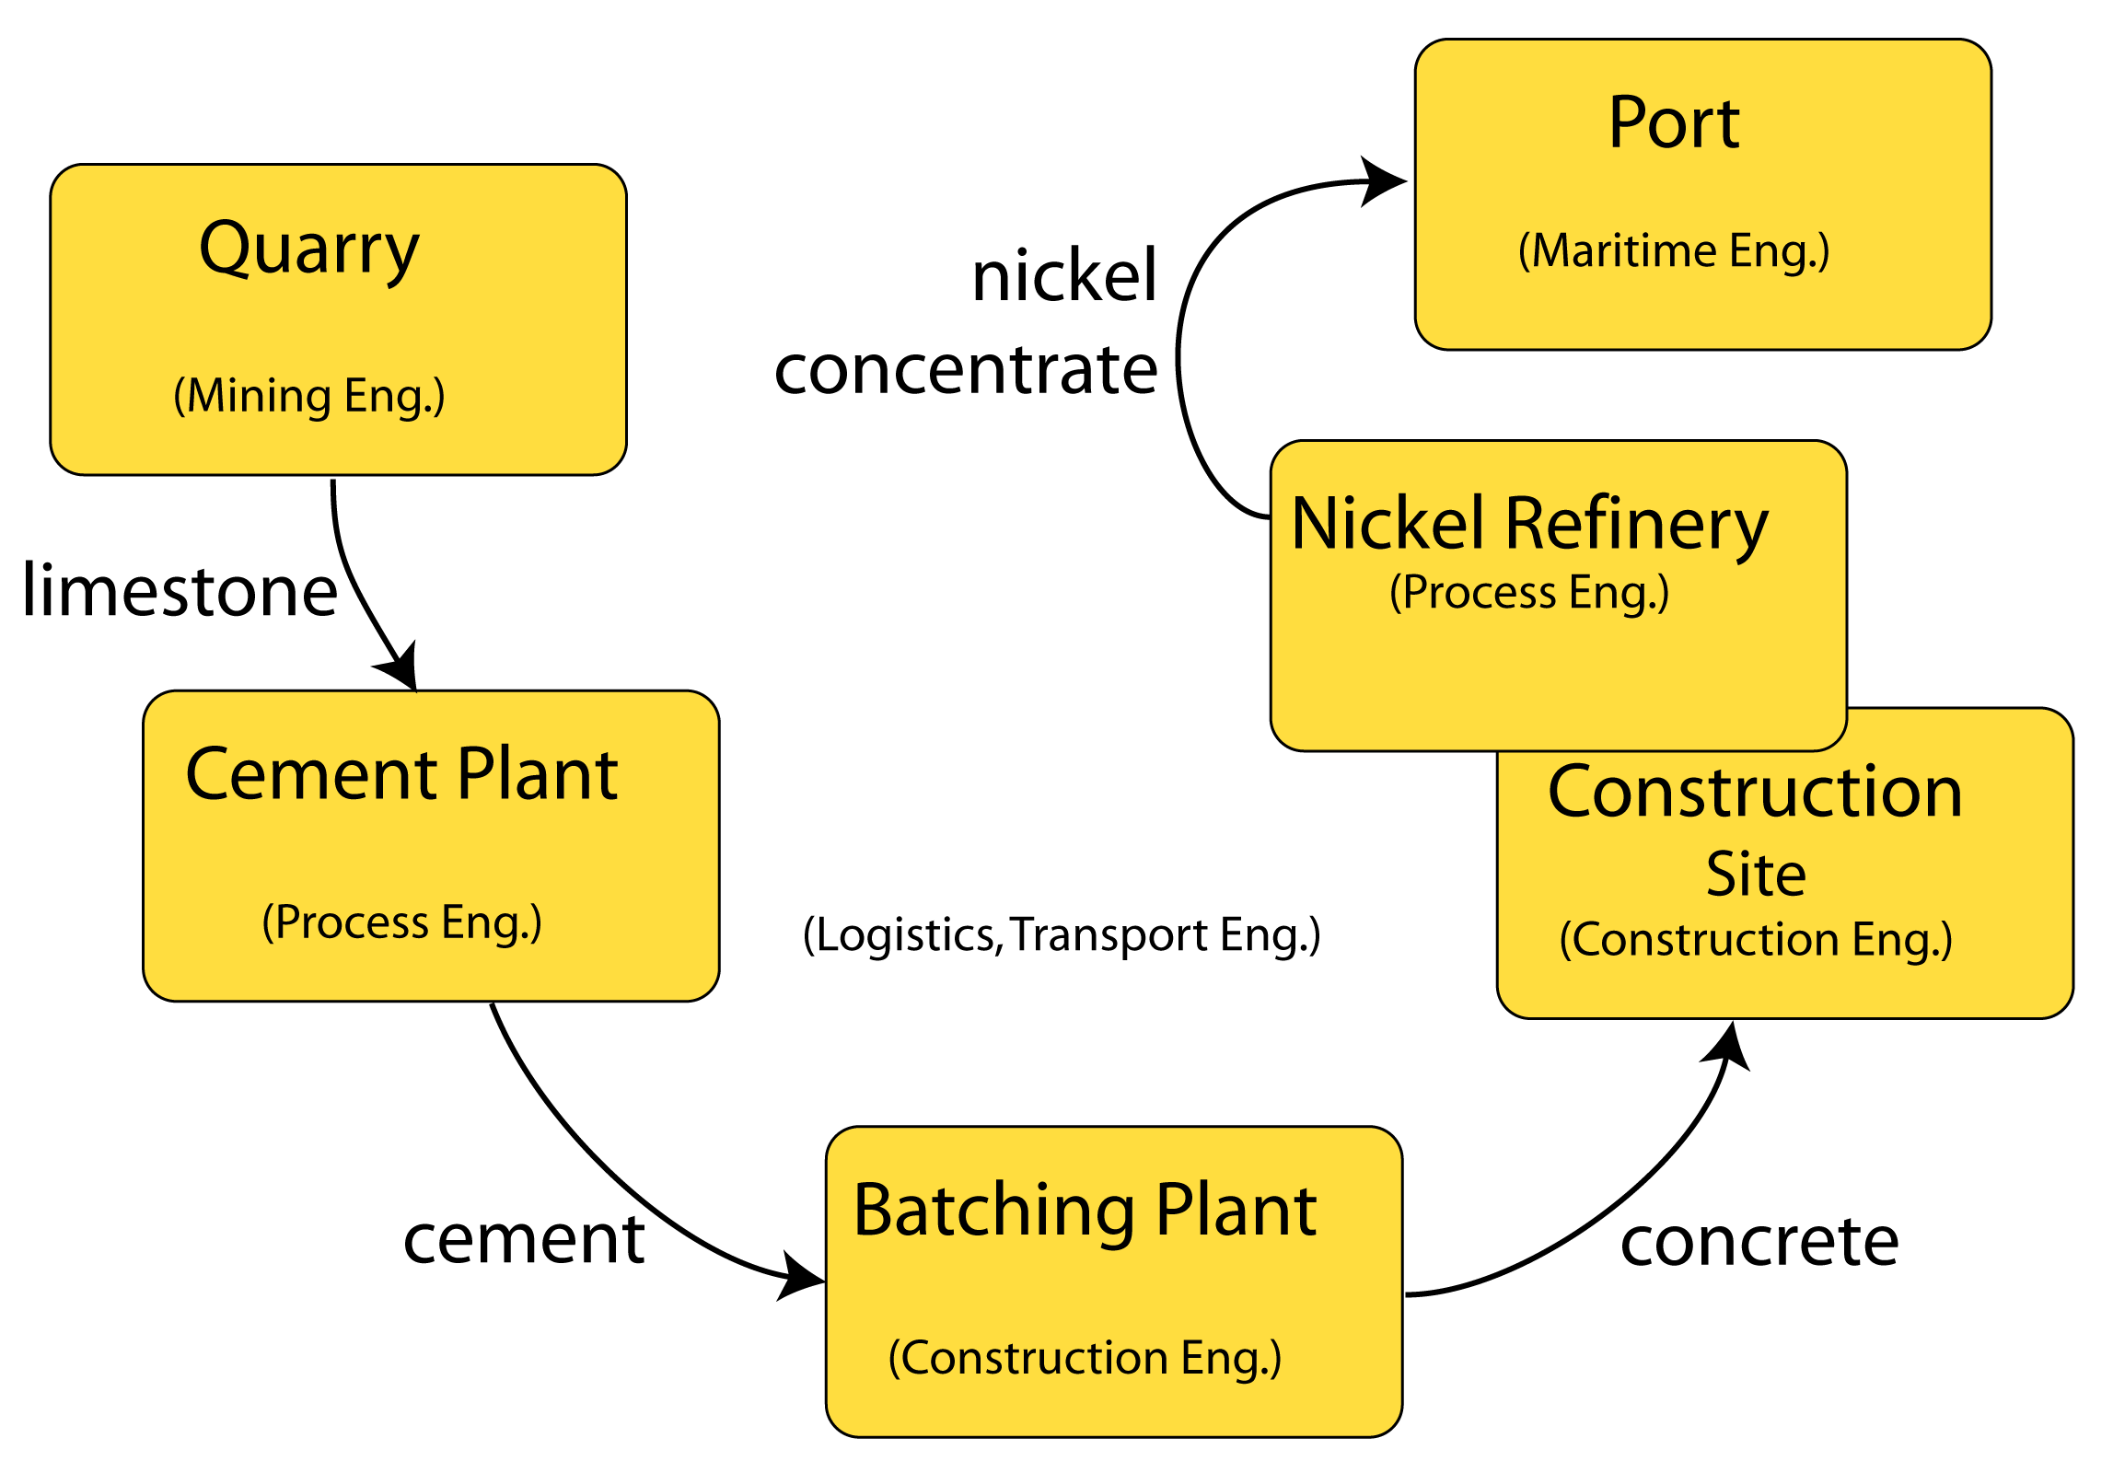
Value System (Porter)
Ch5, The Making of an Expert Engineer
Porter, M. E. (1985). Competitive advantage: creating and sustaining superior performance. New York: Free Press.
Notes:
Note: each enterprise has numerous inputs other than the particular ones shown here – see the last slide

Slide 42
Porter’s Value System
Each firm (or enterprise) operates with a “value system”
The firm has multiple suppliers
Products pass through “channels” to ultimate buyers
Products provide “channel value”
Products contribute to buyer’s value chain
Porter, M. E. (1985). Competitive advantage: creating and sustaining superior performance. New York: Free Press.

Slide 43
Porter’s Value System
Each firm (or enterprise) operates with a “value system”
Product exchange-value > sum of input exchange-values (profit)
Firms differentiate their products to
  Reduce firm’s input costs
  Increase buyer value
  Increase product exchange-value (margin)

Slide 44
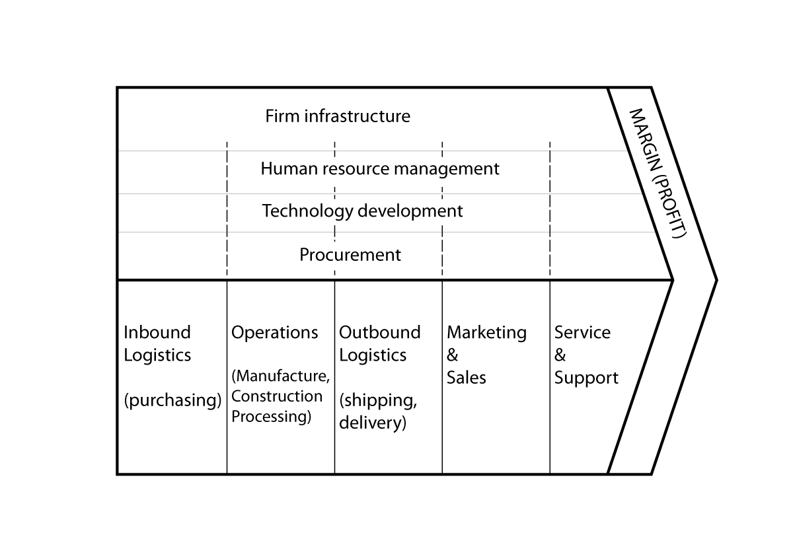
How do engineers contribute value?

Slide 45
Outline
My journeys
Theoretical foundation for engineering
Entrepreneurs, economic development
Value and value creation
Engineering value creation
Why is this important?
Notes:
Learning from Expert Engineers
James Trevelyan, The University of Western Australia
Engineers in New Zealand are experiencing unaccustomed visibility, and not for reasons we can all be comfortable with. The consequences of the Christchurch earthquake have to some extend tarnished the public reputation of the engineering profession.
Is this simply a communication issue? Can we address this by improving engineers’ ability to communicate effectively, with clients, government, and society at large?
12 years of research on engineering practice involving 25 researchers and several hundred engineers tells us that a more extensive response is likely to be needed.
There are many challenges that we, as engineers, will have to overcome to restore our professional reputation and community confidence.
One challenges is to appreciate that communication is much more than simply the transfer of information: a notion that is deeply embedded in the profession today. It is much more than that: communication is the means by which we as engineers collaborate with all the people from whom we need support to deliver the results that our clients and society expect. Technical collaboration is a series of complex socio-technical performances, and expert engineers distinguish themselves by being able to do this better than most others. To do it well, we also need to appreciate that communication is part of relationship building, and the means by which we can shape perceptions of other people.
The research also demonstrates that any engineer can become expert in their chosen areas of specialisation through several years of specially tailored practice with performance evaluation, preferably from experienced peers and colleagues. Engineers who master technical and collaboration skills can look forward to greater career satisfaction, and higher earnings for themselves and their employers.
Knowledge of technical collaboration skills has been allowed to dissipate over time. Now that the knowledge used by experts is available in written form, the next challenge is for practicing engineers to make the effort to learn from it. Such efforts will almost certainly be handsomely rewarded, not the least in terms of enhancing the reputation of the whole profession.
Professor Trevelyan will address several other ways in which engineers can rebuild their professional reputation among clients, government, end-users and society at large.

Slide 46
Engineering Value Creation (1)
Reduce human effort (labour)
Reduce material costs
Reduce energy consumption
Design for improved buyer and end-user experience
Research and technology development
“Efficiency Improvements”

Slide 47
Innovation
Implied link between engineering value creation and innovation (Schumpeter 1911:1934)
What happens if there is no innovation?
Little or no value created?
Schumpeter, J. (1911:1934). The Theory of Economic Development: An Inquiry into Profits, Capital, Credit, Interest, and the Business Cycle. Translated from the 1911 original German, Theorie der wirtschaftlichen Entwicklung. Cambridge, Massachussetts, USA: Harvard University Press.

Slide 48
Co-Creating Shared Value
Shared value: policies and operating practices that enhance competitiveness of firm and, at the same time, advance social and economic conditions of the communities in which the firm operates.
Porter, M. E., & Kramer, M. R. (2011). Creating Shared Value. Harvard Business Review, 101, 15.
See also Ch12 in The Making of an Expert Engineer

Slide 49
Engineering Value Creation (2)
Reduce energy consumption
Improve employee safety, health, skills, education
Reduce material consumption, increase re-use and recycling
Reduce water consumption & discharge
Reduce emissions, environmental impact
Build community respect, capacity
“Sustainability” “Ethics” “Social Licence”
Porter, M. E., & Kramer, M. R. (2011). Creating Shared Value. Harvard Business Review, 100, p62-77.
See also Ch12 in The Making of an Expert Engineer

Slide 50
A Difficult Example
Structural engineer who approves designs for floor slabs and structural beams in residential buildings
Does no design work
Checks designs created by other people
Increases cost, time
How does the engineer create value?

Slide 51
Engineering Value Creation (3)
Providing commercial and technical predictions to build confidence for investment
Accuracy commensurate with level of risk
Higher accuracy requires greater investment
+/- 20% often acceptable in early stages

Slide 52
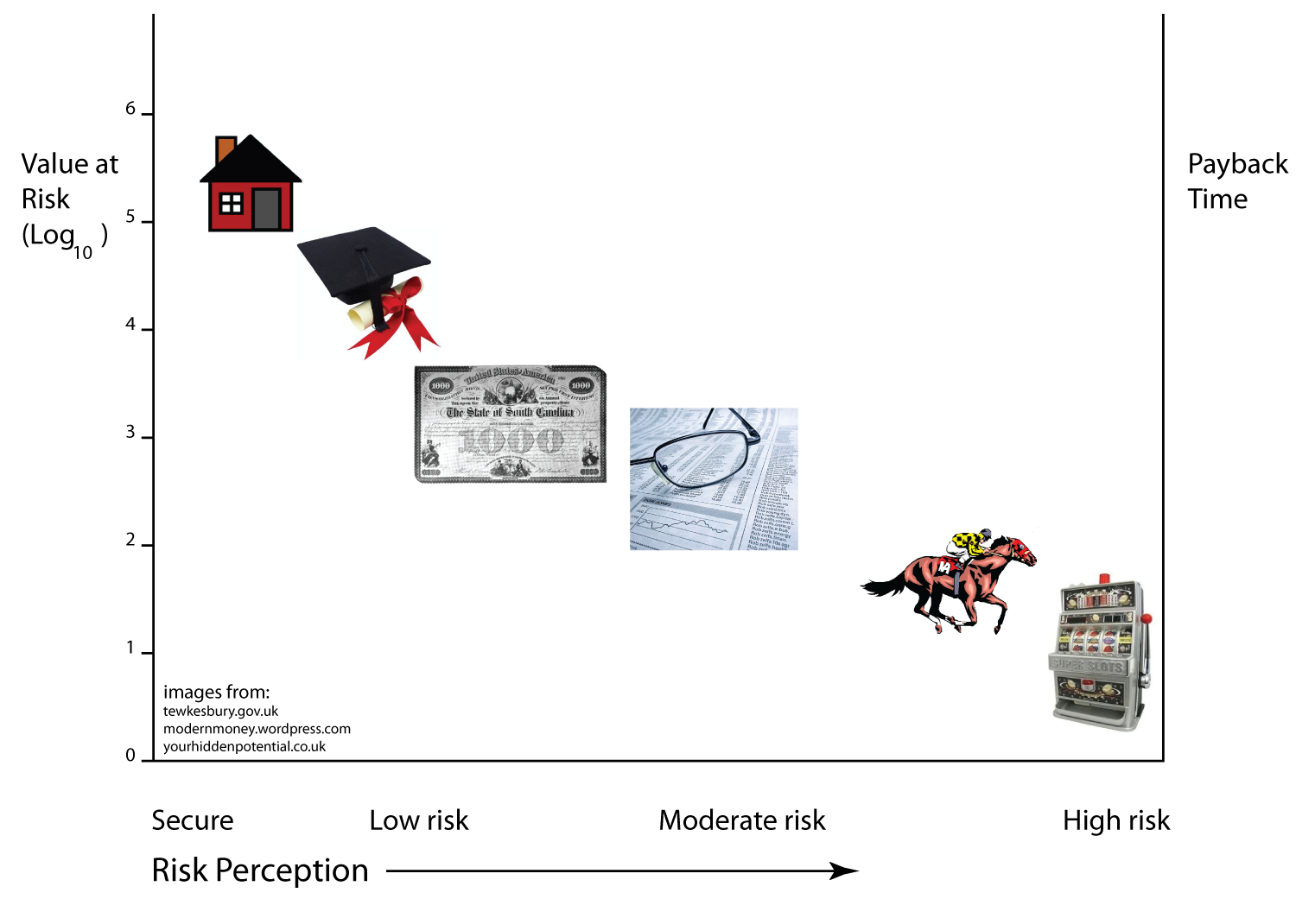

Investor Perceptions of Risk
Ch11: The Making of an Expert Engineer

Slide 53
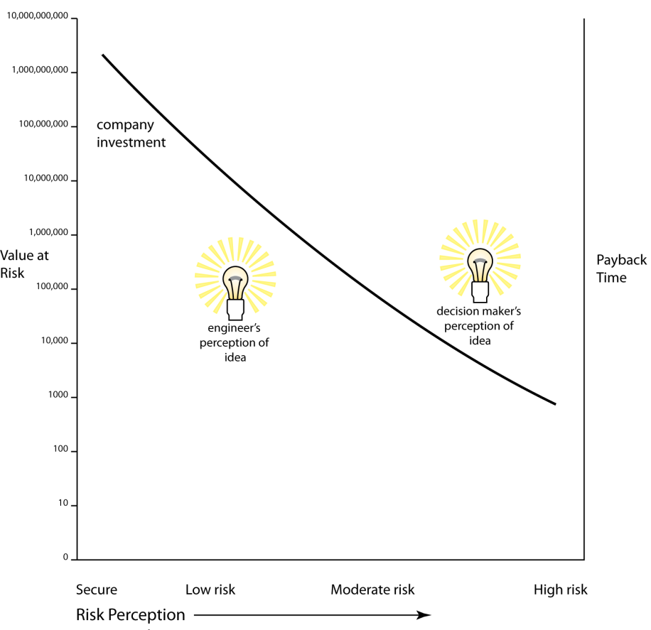
Perceptions of risk & cost
Ch11: The Making of an Expert Engineer

Slide 54
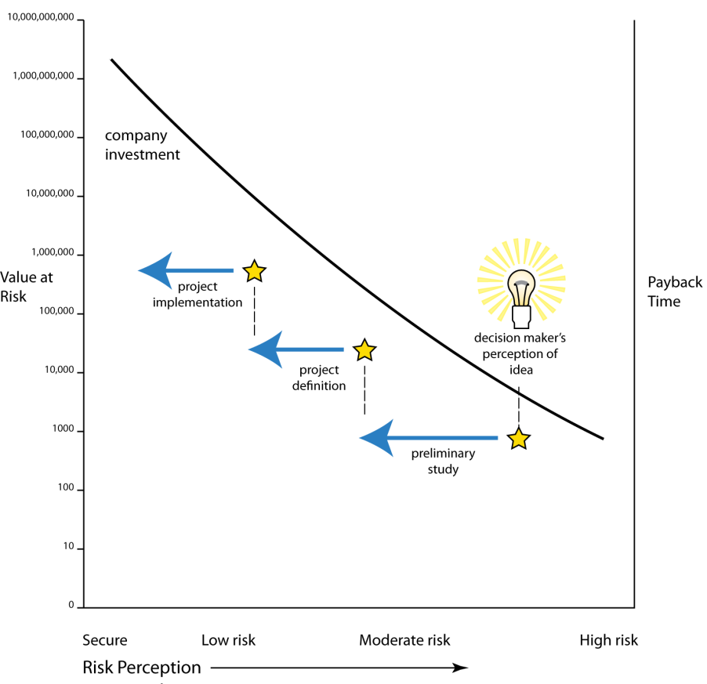
Perceptions of risk & cost
Ch11: The Making of an Expert Engineer

Slide 55
Reducing uncertainty
Less exciting?
Less challenging?
Tolerate lower return
Tolerate longer payback time
More capital available

Slide 56
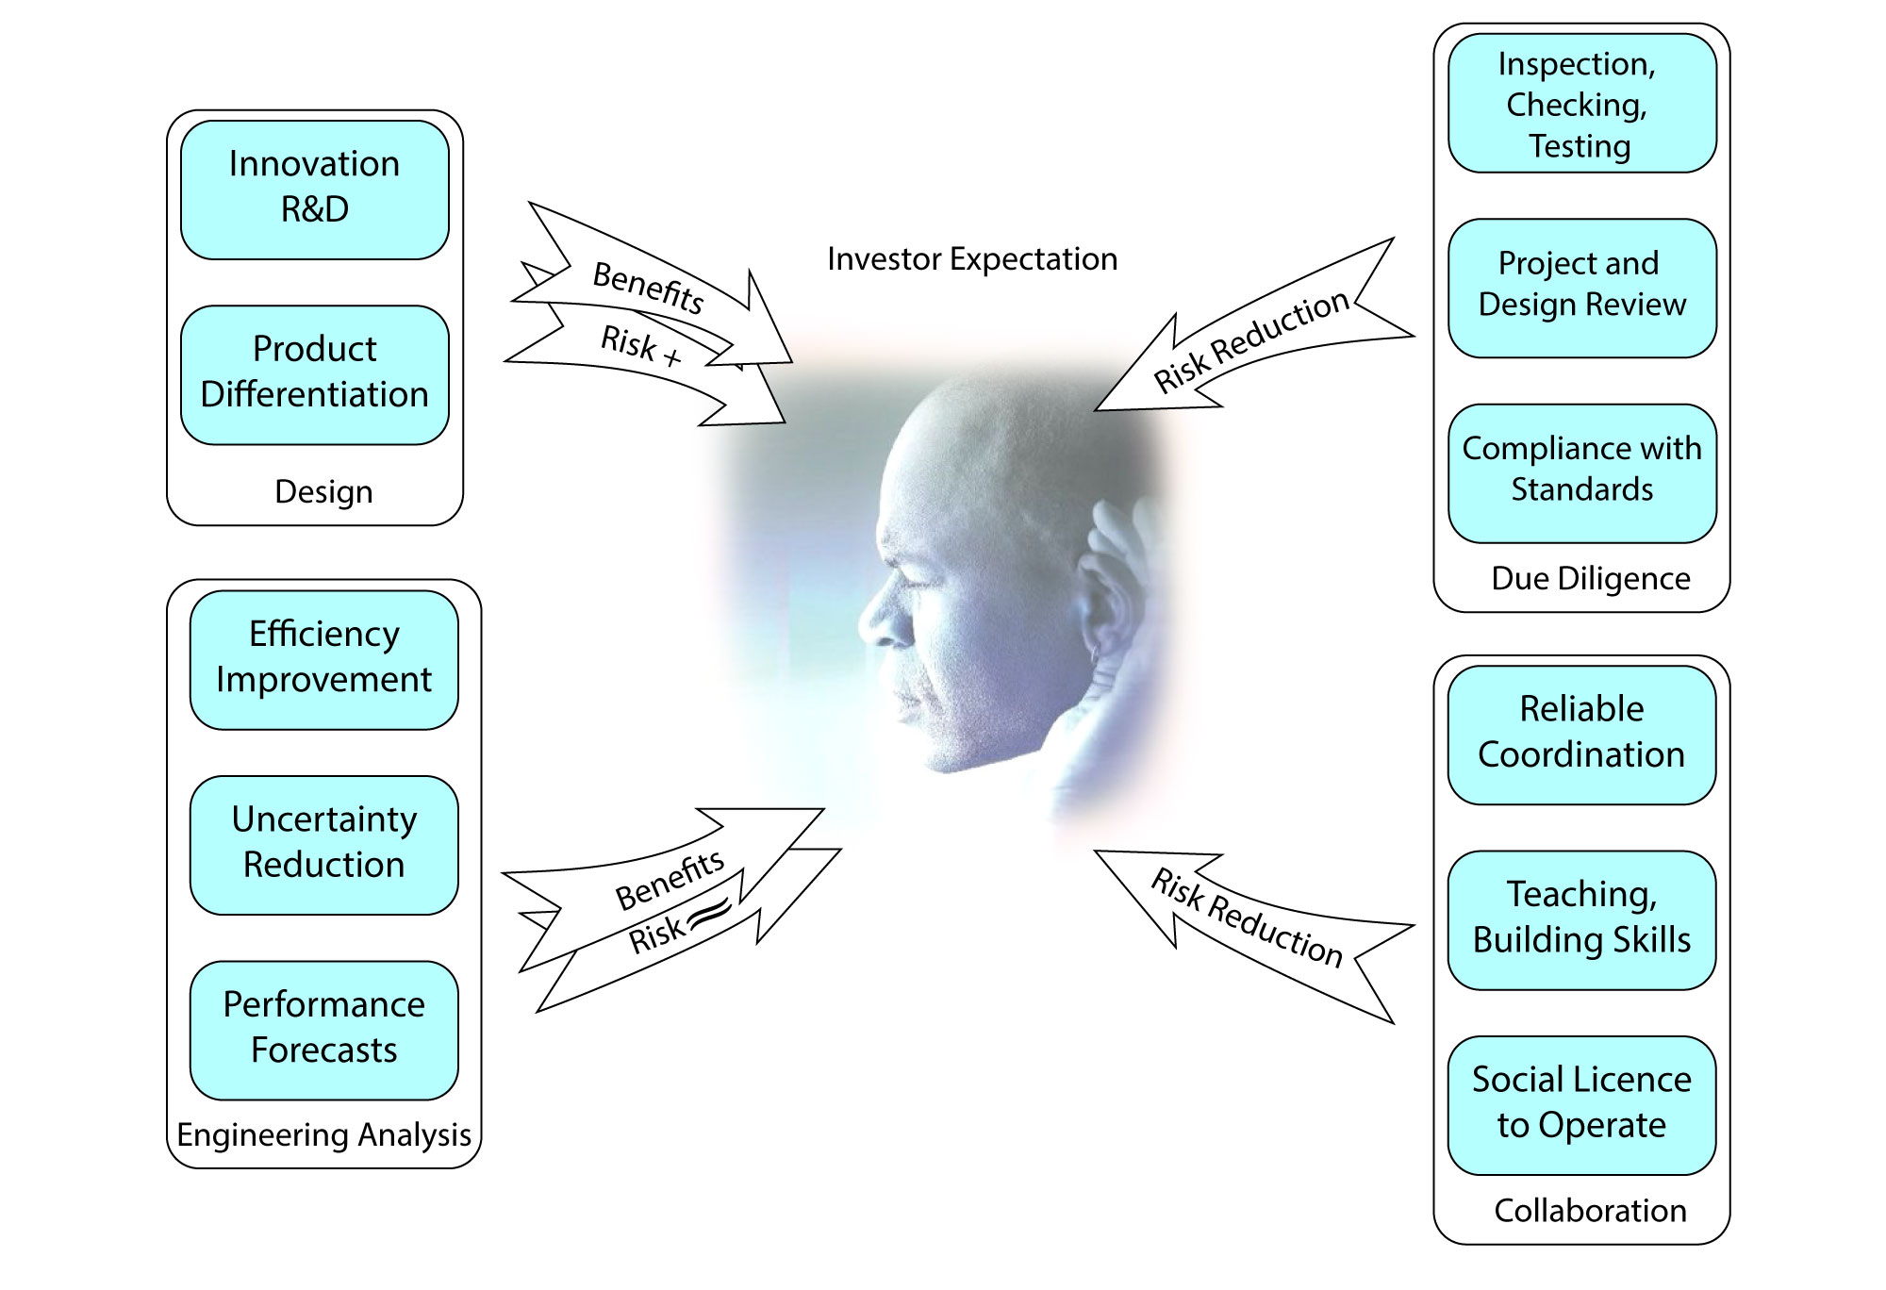
Influencing Investor Perceptions

Slide 57
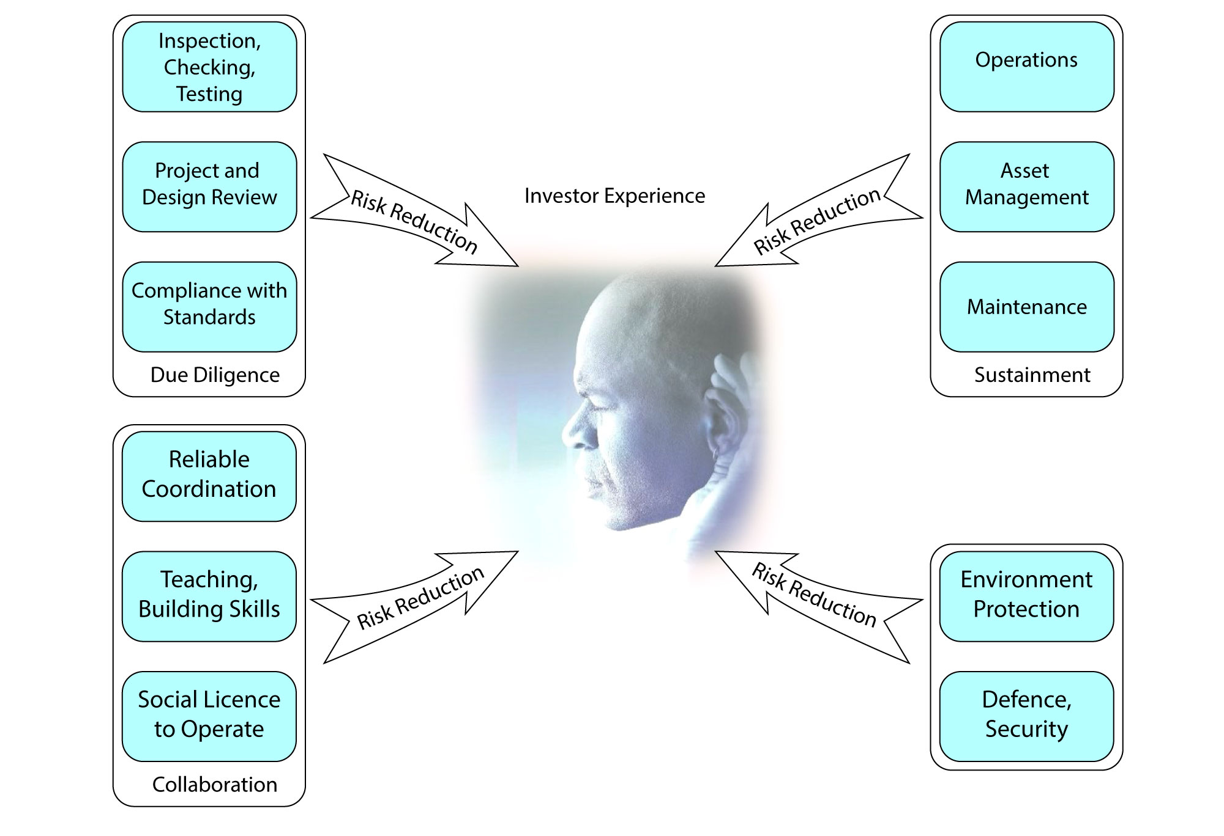
Influencing Investor Experiences

Slide 58
Engineering Value Creation, Delivery
Reduce human effort, material, energy
Reduce uncertainty, reduce design margins
Design for improved buyer and end-user experience – product differentiation (Porter)
Innovation – transformation of ideas into innovative products and services (Zhang)
Shared value creation – health, safety, environment, education, capacity building (Kramer, Porter)
Providing commercial and technical predictions to build confidence for investment (Trevelyan)
Organisation, coordination for reliable delivery with sufficient performance to justify repeat business (Trevelyan)
Zhang, Y., & Gregory, M. (2011). Managing global network operations along the engineering value chain. International Journal of Operations and Production Management, 31(7), 736-764.

Slide 59
Engineering Value Protection
Defence equipment and services
Shared value creation – health, safety, environment, education, capacity building (Kramer, Porter)
Sustainment: operations, engineering asset management, maintenance (Trevelyan)

Slide 60
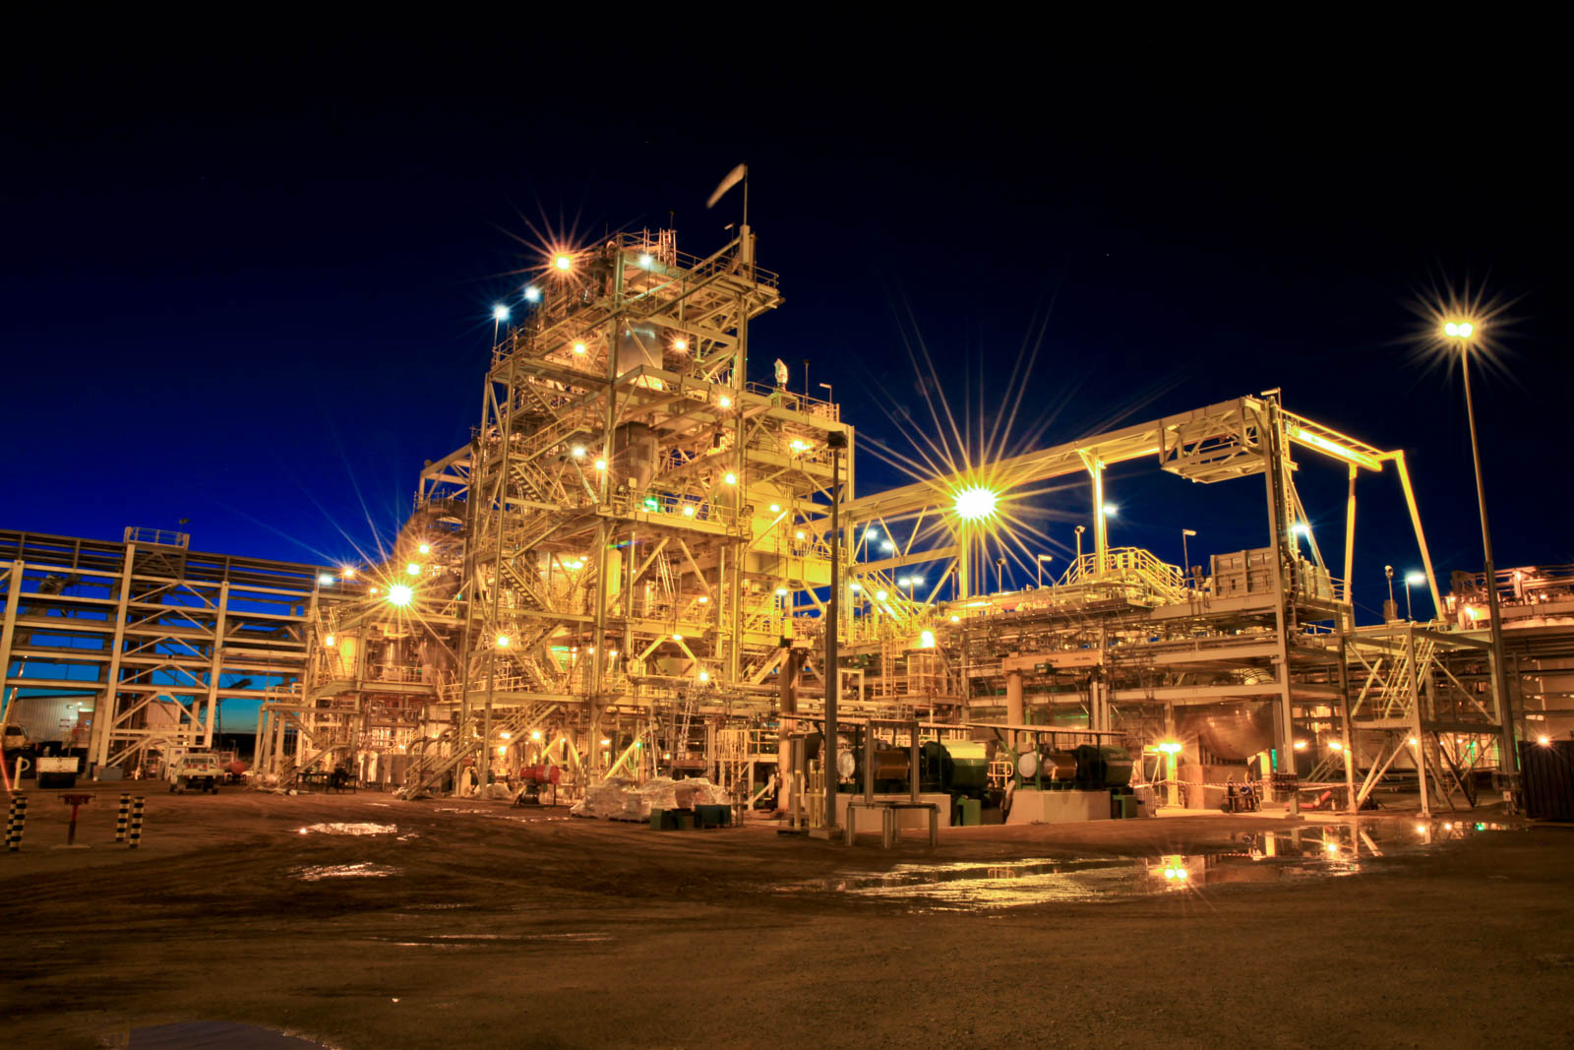
Ravensthorpe Nickel Refinery
Conceived 2004 – Au$1.4 Bn
Cost till 2008 – Au$2.6 Bn
Sold to First Quantum for Au$250m in 2009
2.4 Billion Dollars in value destroyed

Slide 61
Success rate for projects US$100 million – $1 billion?
  (Success = financial return > 50% forecast @ FID)
Success rate for projects > US$1 billion?
Merrow, E. W. (2011). Industrial Megaprojects: Concepts, Strategies, and Practices for Success. New Jersey, John Wiley & Sons.

Slide 62
Outline
My journeys
Theoretical foundation for engineering
Entrepreneurs, economic development
Value and value creation
Engineering value creation
Why is this important?
Notes:
Learning from Expert Engineers
James Trevelyan, The University of Western Australia
Engineers in New Zealand are experiencing unaccustomed visibility, and not for reasons we can all be comfortable with. The consequences of the Christchurch earthquake have to some extend tarnished the public reputation of the engineering profession.
Is this simply a communication issue? Can we address this by improving engineers’ ability to communicate effectively, with clients, government, and society at large?
12 years of research on engineering practice involving 25 researchers and several hundred engineers tells us that a more extensive response is likely to be needed.
There are many challenges that we, as engineers, will have to overcome to restore our professional reputation and community confidence.
One challenges is to appreciate that communication is much more than simply the transfer of information: a notion that is deeply embedded in the profession today. It is much more than that: communication is the means by which we as engineers collaborate with all the people from whom we need support to deliver the results that our clients and society expect. Technical collaboration is a series of complex socio-technical performances, and expert engineers distinguish themselves by being able to do this better than most others. To do it well, we also need to appreciate that communication is part of relationship building, and the means by which we can shape perceptions of other people.
The research also demonstrates that any engineer can become expert in their chosen areas of specialisation through several years of specially tailored practice with performance evaluation, preferably from experienced peers and colleagues. Engineers who master technical and collaboration skills can look forward to greater career satisfaction, and higher earnings for themselves and their employers.
Knowledge of technical collaboration skills has been allowed to dissipate over time. Now that the knowledge used by experts is available in written form, the next challenge is for practicing engineers to make the effort to learn from it. Such efforts will almost certainly be handsomely rewarded, not the least in terms of enhancing the reputation of the whole profession.
Professor Trevelyan will address several other ways in which engineers can rebuild their professional reputation among clients, government, end-users and society at large.

Slide 63
Expert engineers understand value creation!
Earn 2-5 times more than other engineers
Earn more than developed country engineers
Provide sufficient value for employers to pay high salaries
Use skills and knowledge that any engineer can learn

Slide 64
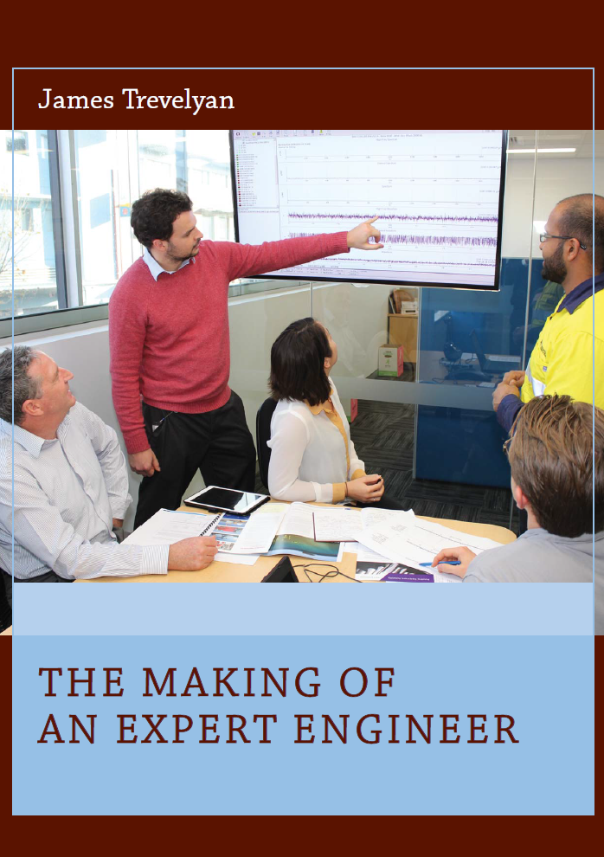
Where to learn more
Engineering practice: the work that engineers do that is common to all disciplines.
Knowledge used by expert engineers.
Help younger engineers develop attributes of experts quickly.

Slide 65

Notes:
And I also take photos of flowers.

